Slide 1

File Management in Linux

Slide 2
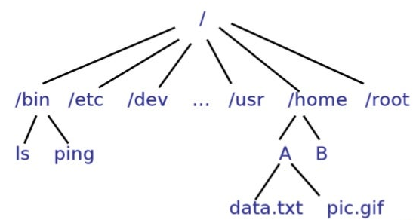
What is a file system?
Files are usually stored on secondary storage systems.
File system → how the data is organized in these storage systems.
Different types of file systems exists: FAT, exFAT, NTFS, APFS, ext4, etc

Slide 3
File System Navigation
2 ways to navigate a file system:
Absolute paths:
Always start from the root (/) → “/home/marta”
Relative paths:
We use . and .. to navigate the file system.
. refers to the current directory → .file1 refers to the file1 stored in /home/marta. The absolute path would be /home/marta/file1
.. refers to the parent directory → if we are in /home/marta, .. would refer to /home
There is only 1 absolute path for a file, but it can have multiple relative paths.
../bin/file
../bin/../bin/file
etc

Slide 4


Slide 5
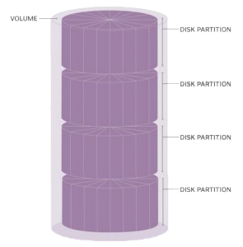
Partitions
A disk can be split into different partitions with different file systems.
Partition → logical division of the disk, independent of the other partitions.

